Slide 1


REAL DREAM
Discover
YOUR DREAM HOME TODAY
UMA THIYAGARAJAN

Slide 2




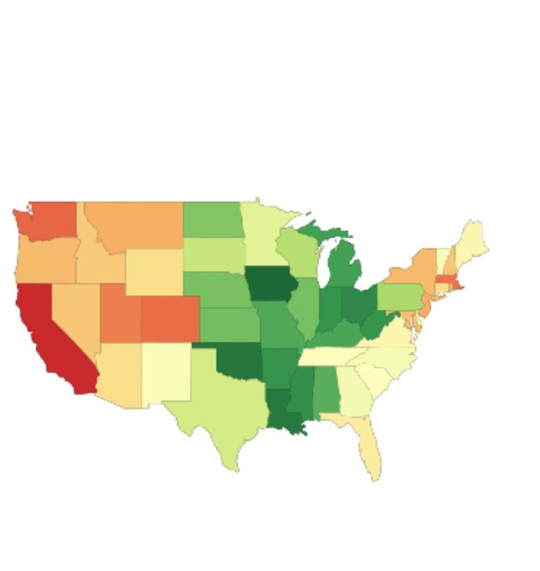
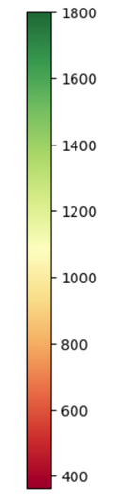


Want to know how big and where to buy a home?
400 sqft
800 sqft
1200sqft
1800 sqft
California
Montana
800 sqft
Dakota
Iowa
November 2024 Median house price - Iowa -$241000
Area sqft
House Area affordable with Iowa state Median house Price
Recommended House area : 1800 sqft

Slide 3

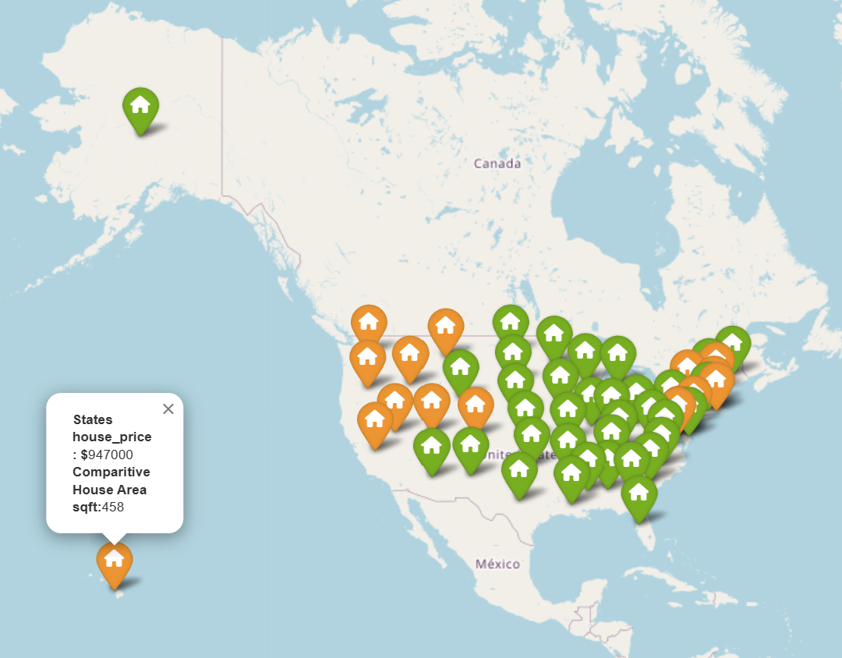
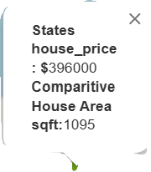
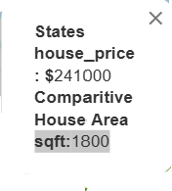
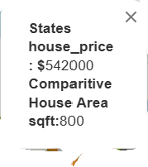
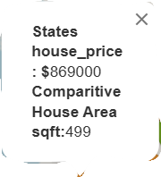
House price vs Size of the house
Interactive map

Slide 4
Talk about the terms used here like inflation cpi

Slide 5
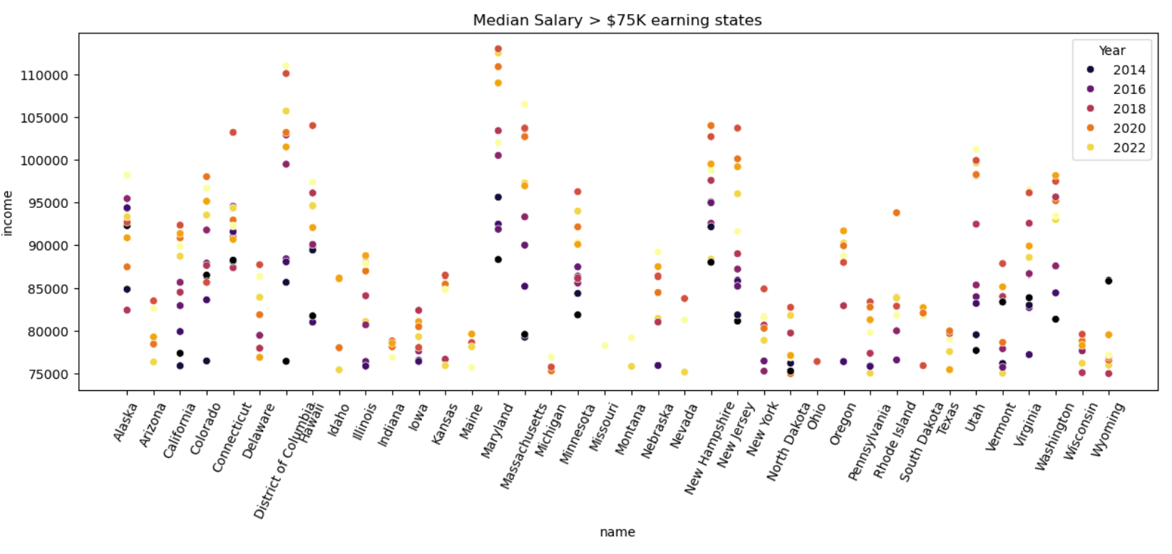
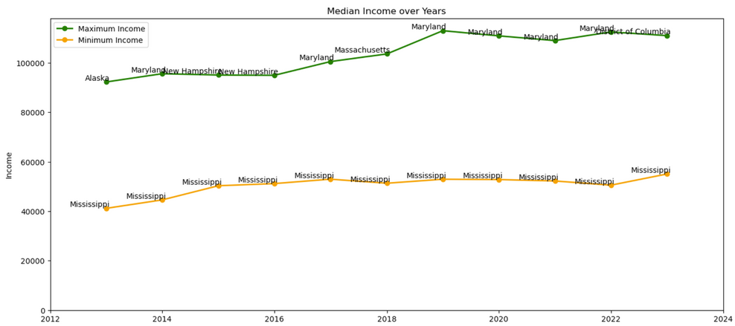
* How does the salary distribution change in the states?
Understanding Income
Data Analyst Median US Salary 75K -80K
Below chart shows states with median salary greater than 75K
Tennessee not in the list (sorry)
States
States with high and low Salary over the years

Slide 6
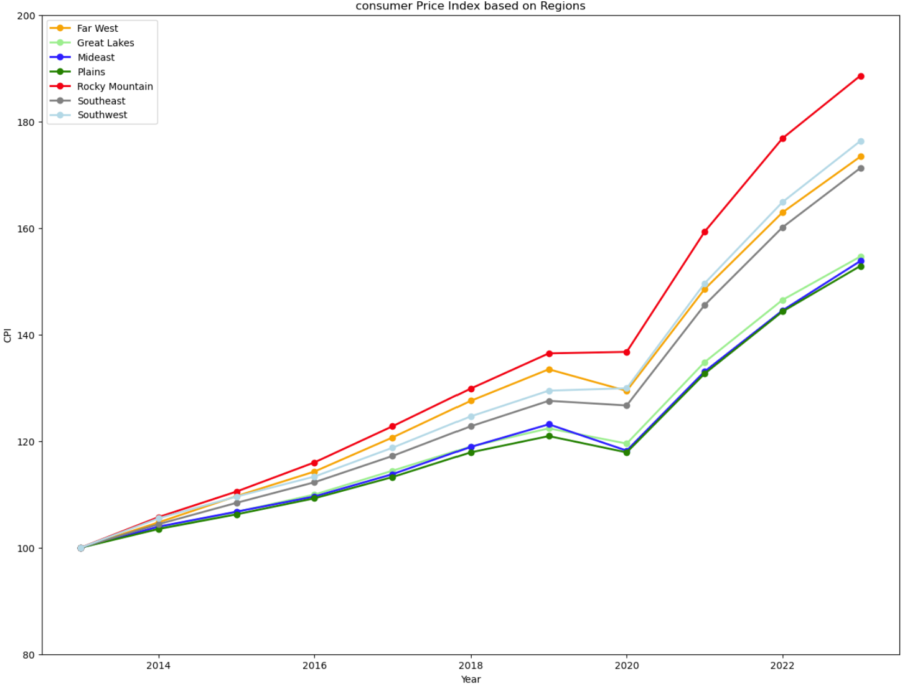
Know about Consumer Price Index
All states show steady rise in the CPI since 2020
States like California, Utah, Texas and few other show high CPI
2023 CPI seems to be at peak over the years in analysis

Slide 7
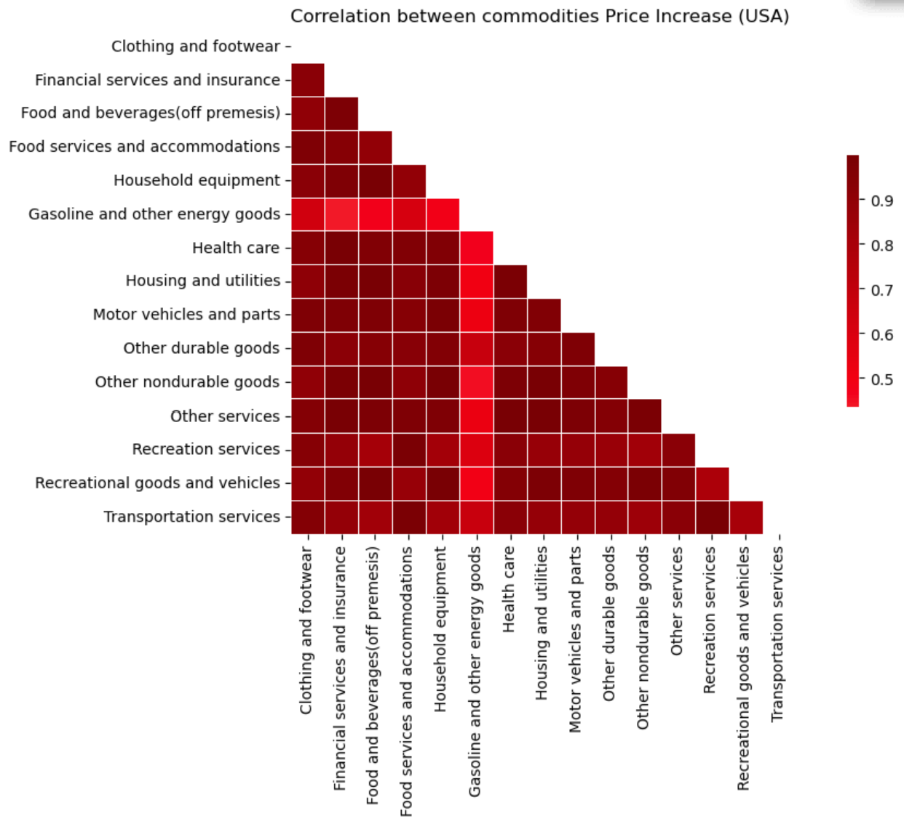
Commodities Price analysis
Inflation

Slide 8

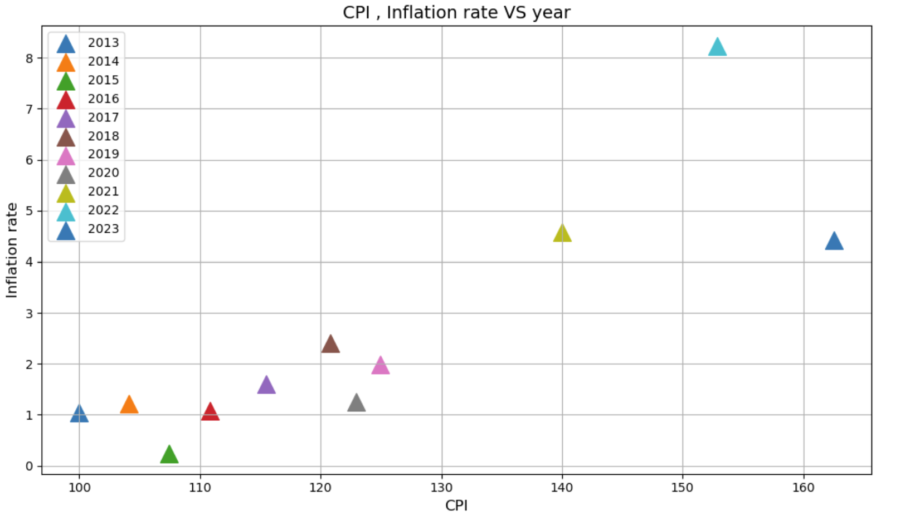

Slide 9
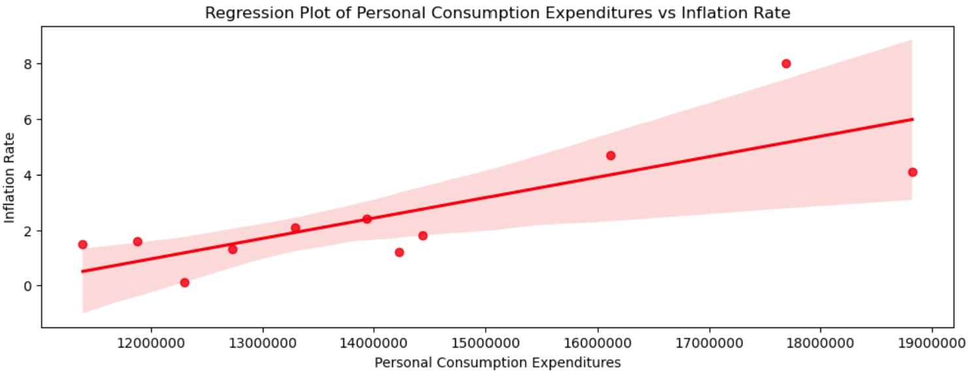
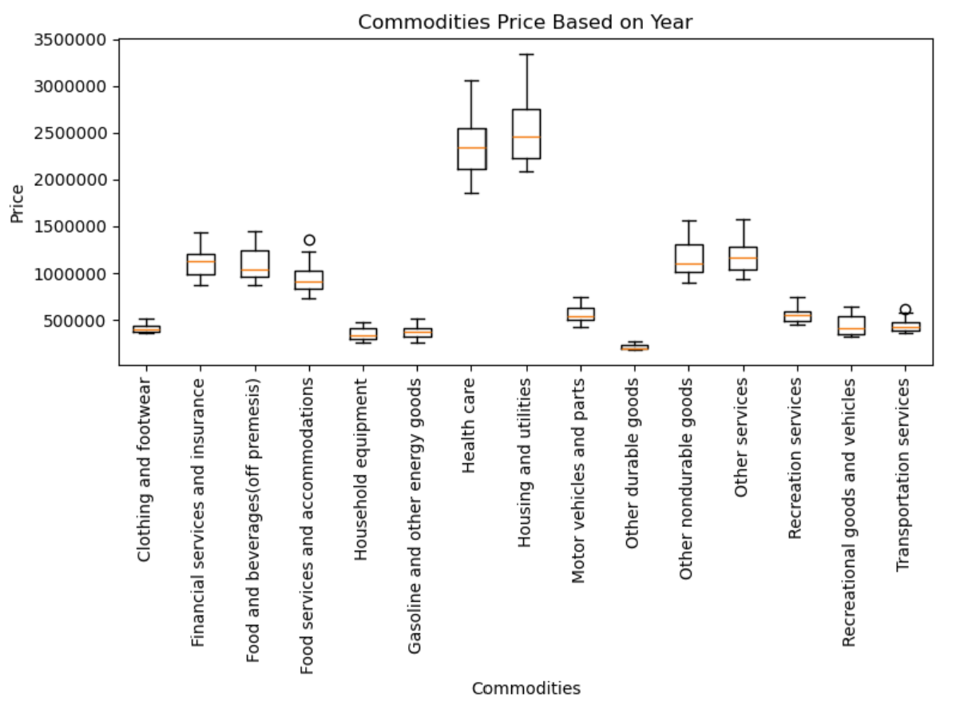















# What happens to the cost of everyday items like food, fuel, and housing when inflation rises?
USA

Slide 10
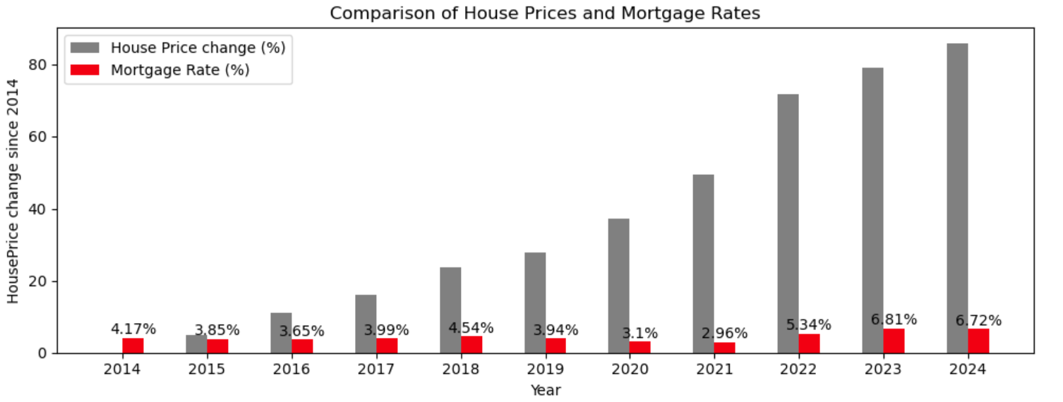
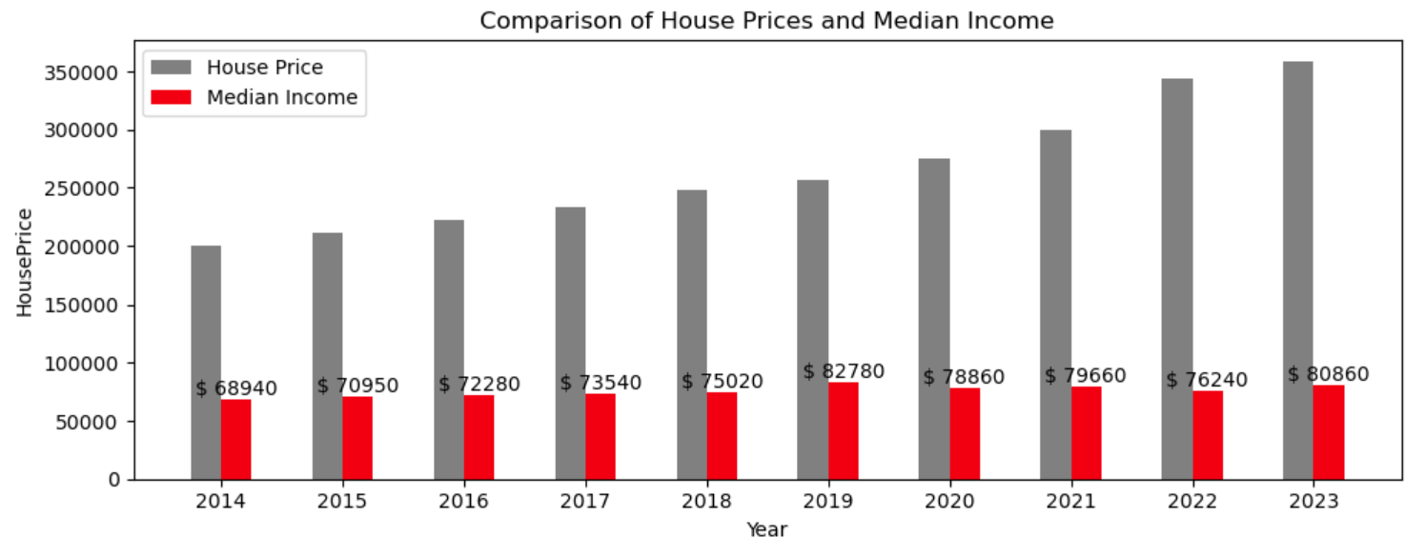

Slide 11
